Slide 1



Java Bootcamp 2018
Class 5:

Slide 2

Java Bootcamp 2018 - Class 5: Spring
What is Spring?
The most popular application development framework for Java
For creating high performing, easily testable, reusable code without any lock-in

Slide 3
Java Bootcamp 2018 - Class 5: Spring
What is Spring?
an open source application framework
container for the Java platform
a lightweight solution for enterprise applications
non-invasive (POJO based)
is modular
extendible for other frameworks
de facto standard of Java Enterprise Application

Slide 4
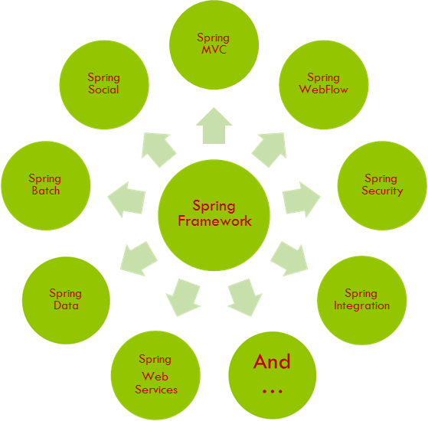
Java Bootcamp 2018 - Class 5: Spring

Slide 5
Java Bootcamp 2018 - Class 5: Spring
Spring Framework - Goals
make the common tasks easier
promote good programming practice
you can focus on the domain problems

Slide 6
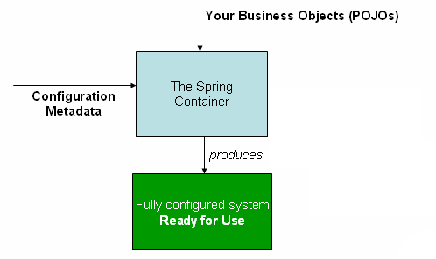
Java Bootcamp 2018 - Class 5: Spring
Spring Core - IoC container
creates beans
wires beans
manages beans lifecycle
BeanFactory Container

Slide 7
Java Bootcamp 2018 - Class 5: Spring
Spring Core - Dependency Injection
software design pattern that implements IoC
allows a program design to follow the dependency inversion principle
injection → passing of a dependency (service) to a dependent object (client)
the service is made part of the client’s state
passing the service to the client rather than allowing a client to build or find the service is the fundamental requirement of the pattern
exists in two major variants
setter injection
constructor injection

Slide 8
Java Bootcamp 2018 - Class 5: Spring
Spring Core - ApplicationContext
all functionality from BeanFactory container and more
central interface in a Spring app for providing configuration information
read at runtime, can be reloaded if necessary
ability to resolve textual msgs from properties file
Support for internationalization
ability to publish application events to interested event listeners
Inheritance from parent context

Slide 9
Java Bootcamp 2018 - Class 5: Spring
Spring Core - ApplicationContext
TEST Context
PROD Context
APPLICATION
APPLICATION
DAO
3rd party web-service
DAO
3rd party web-service
HTTP
MOCK
in-memory DB
MySQLCluster

Slide 10
Java Bootcamp 2018 - Class 5: Spring
Spring Core - Beans lifecycle
after bean instantiation, it might be required to perform some initialization to get it into a usable state → @PostConstruct
BeanPostProcessor interface (postProcessBeforeInitialization and postProcessAfterInitialization)
when no longer required, some cleanup may be required → @PreDestroy
Beans instantiated
Dependencies injected
Post process
Bean ready to use
Destroy

Slide 11
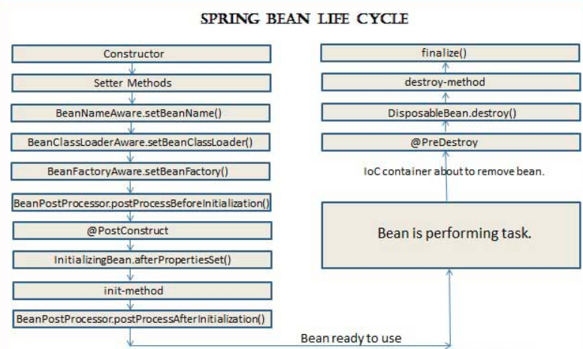
Java Bootcamp 2018 - Class 5: Spring
Spring Core - Beans lifecycle

Slide 12
Java Bootcamp 2018 - Class 5: Spring
Spring Core - XML
argument resolution
<bean id="b1" class="org.examples.ClientServiceBean">
<constructor-arg ref="b2"/>
<constructor-arg ref="b3"/>
</bean>
argument type matching
<bean id="b2" class="ClientService" factory-method="getInstance">
<constructor-arg type="int" value="7500000"/>
<constructor-arg type="java.lang.String" value="42"/>
</bean>
argument index
<bean id="b3" factory-bean="factory" factory-method="getInstance"/>
<constructor-arg index="0" value="75"/>
<constructor-arg index="1" value="42"/>
</bean>
beans.xml

Slide 13
Java Bootcamp 2018 - Class 5: Spring
Spring Core - Annotations
Spring annotations
@Autowired
@Qualifier
@Required
@Value
Context
@Scope
@Bean
@DependsOn
@Lazy
JSR 250
@Resource
@PostConstruct
@PreDestroy
Transactional
@Transactional

Slide 14
Java Bootcamp 2018 - Class 5: Spring
Spring Core - Annotations
package writer; public interface IWriter { public void write(String message); }
public class SimpleWriter implements IWriter { public void write(String message) { System.out.println(message); } }
@Service
public class NiceWriter implements IWriter { public void write(String message) { System.out.println("The string is " + s); } }
package client; import writer.IWriter; @Service
public class WriterClient { private IWriter writer;
@Autowired public void setWriter(IWriter writer) { this.writer = writer; } public void run() { writer.write("This is my test"); } }

Slide 15
Java Bootcamp 2018 - Class 5: Spring
Spring Web
provides basic web-oriented integration features
Web MVC
Web-Servlet module, contains Spring’s model-view-controller implementation for web apps
@Controller public class GreetingController { @GetMapping("/greeting") public String greeting(@RequestParam(name="name", required=false, defaultValue="World") String name, Model model) { model.addAttribute("name", name); return "greeting"; } }
<!DOCTYPE HTML> <html xmlns:th="http://www.thymeleaf.org"> <head> <title>Getting Started: Serving Web Content</title> <meta http-equiv="Content-Type" content="text/html; charset=UTF-8" /> </head> <body> <p th:text="'Hello, ' + ${name} + '!'" /> </body> </html>

Slide 16
Java Bootcamp 2018 - Class 5: Spring
Spring Web - REST
@PutMapping("/employees/{id}") Employee replaceEmployee(@RequestBody Employee newEmployee, @PathVariable Long id) { return repository.findById(id) .map(employee -> { employee.setName(newEmployee.getName()); employee.setRole(newEmployee.getRole()); return repository.save(employee); }) .orElseGet(() -> { newEmployee.setId(id); return repository.save(newEmployee); }); } @DeleteMapping("/employees/{id}") void deleteEmployee(@PathVariable Long id) { repository.deleteById(id); } }
ability to set up a REST API in minutes
@RestController class EmployeeController { private final EmployeeRepository repository; EmployeeController(EmployeeRepository repository) { this.repository = repository; } // Aggregate root @GetMapping("/employees") List<Employee> all() { return repository.findAll(); } @PostMapping("/employees") Employee newEmployee(@RequestBody Employee newEmployee) { return repository.save(newEmployee); }

Slide 17
Java Bootcamp 2018 - Class 5: Spring
Spring Data Access - JDBC
Data access/Integration
JDBC abstraction layer
JdbcTemplate class
simplifies usage of JDBC
e.g., no connection opening/closing handling needed
focus on SQL queries/updates
includes processing of ResultSets
exceptions manipulation and simplification

Slide 18
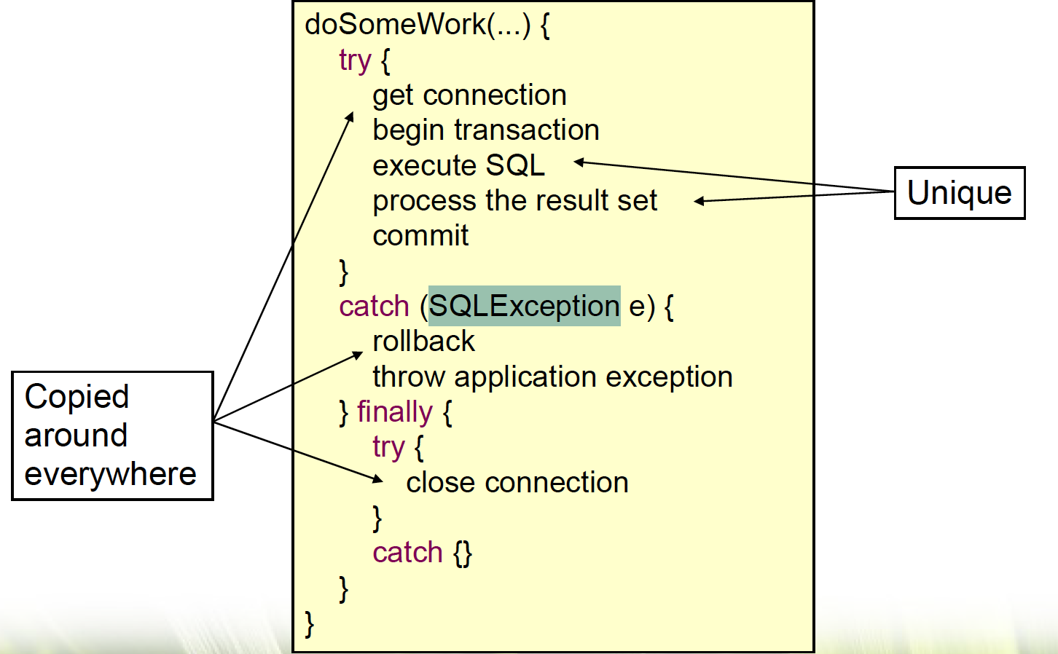
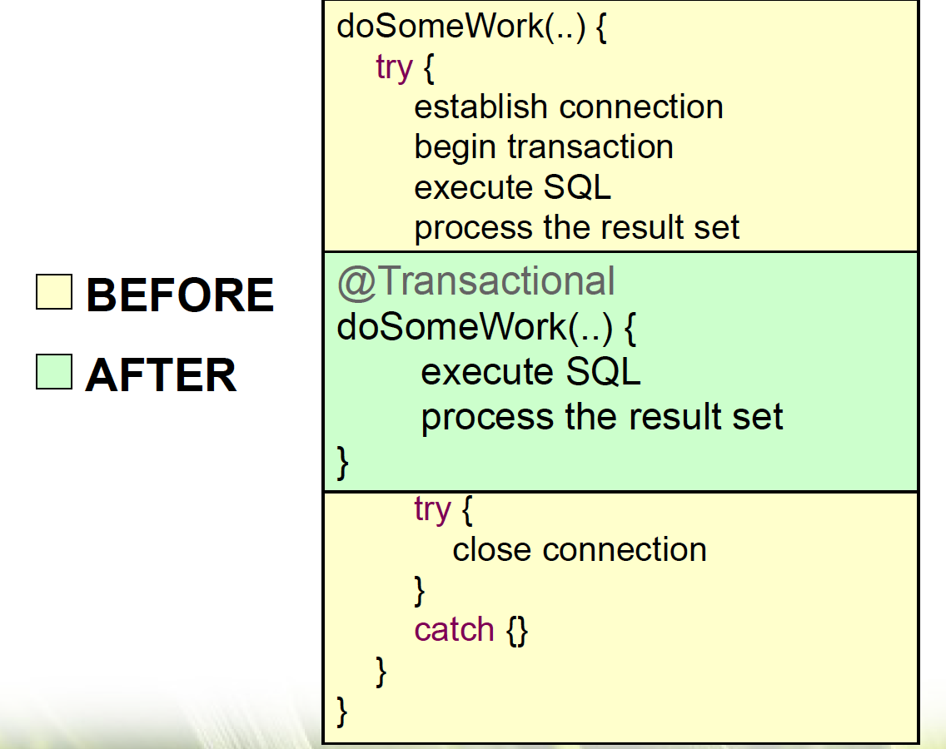
Java Bootcamp 2018 - Class 5: Spring
Spring Data Access - JDBCTemplate

Slide 19
Java Bootcamp 2018 - Class 5: Spring
Spring Data Access - Hibernate
ORM
integration layers for popular ORM APIs, including JPA, JDO, Hibernate and iBatis
SessionFactory
HibernateTransactionManager

Slide 20
Java Bootcamp 2018 - Class 5: Spring
Spring Data
eases usage of data access technologies
relational and non-relational dbs
repository and custom object-mapping abstractions
package hello; import java.util.List; import org.springframework.data.repository.CrudRepository; public interface CustomerRepository extends CrudRepository<Customer, Long> { List<Customer> findByLastName(String lastName); }

Slide 21
Java Bootcamp 2018 - Class 5: Spring
Spring Testing
spring-test module supports the unit testing and integration testing of Spring components with JUnit or TestNG
consistent loading of Spring ApplicationContexts and caching of those. It also provides mock objects that you can use to test your code in isolation
org.springframework.test.util package contains several general purpose utilities for use in unit and integration testing.
@SpringBootTest
Integration testing support (e.g., with ApplicationContext)

Slide 22
Java Bootcamp 2018 - Class 5: Spring
Spring AOP
aspects, instrumentation
Cross-cutting concerns
ability to define method-interceptors and pointcuts to cleanly decouple code
Aspect → Integration with AspectJ

Slide 23
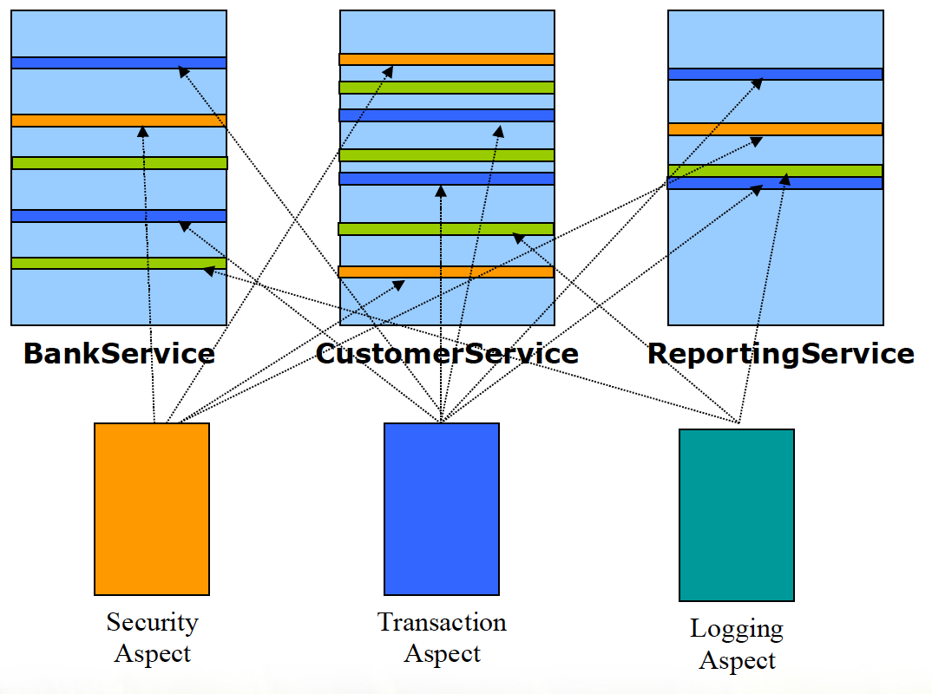
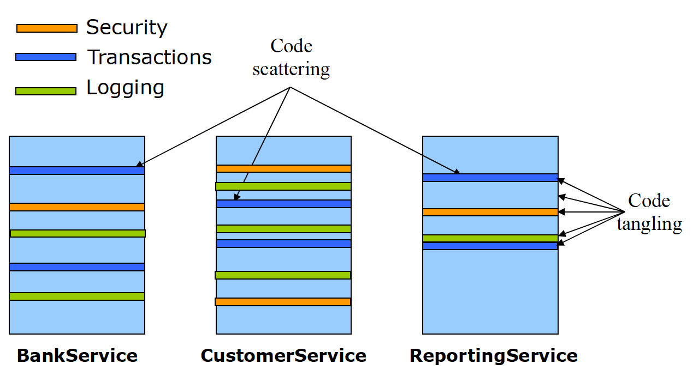
Java Bootcamp 2018 - Class 5: Spring
Spring AOP - Cross cutting concerns
Code Tangling / Code Scattering

Slide 24
Java Bootcamp 2018 - Class 5: Spring
Spring Security
framework for adding security to the apps implemented with Spring
adding both authentication and authorization to java apps
promotes programming to interfaces
@Configuration @EnableWebSecurity public class WebSecurityConfig extends WebSecurityConfigurerAdapter { @Override protected void configure(HttpSecurity http) throws Exception { http .authorizeRequests() .antMatchers("/", "/home").permitAll() .anyRequest().authenticated() .and() .formLogin() .loginPage("/login") .permitAll() .and() .logout() .permitAll(); }
looses coupling with minimal effort
supports eager instantiation and lazy loading
provides control over object lifecycle

Slide 25
Java Bootcamp 2018 - Class 5: Spring
Spring JTA
API for managing transactions in Java
start, commit, rollback transactions
ability to manage multiple resources (dbs, messaging servers) in same transaction
@Transactional

Slide 26
Java Bootcamp 2018 - Class 5: Spring
Spring Messaging - JMS
features for producing and consuming messages
RabbitMQ and ActiveMQ integration
JmsTemplate
@EnableJMS
@JmsListener

Slide 27
Java Bootcamp 2018 - Class 5: Spring
Spring Boot - Reference
https://spring.io/guides

Slide 28
Java Bootcamp 2018 - Class 5: Spring
Any questions?

